Slide 1
ER Modeling

Slide 2
ER Model
ER model stands for an Entity-Relationship Model. It is a high-level data model.
This model is used to define the data elements and relationship for a specified system.
It develops a conceptual design for the database. It also develops a very simple and easy to design view of data.
In ER modeling, the database structure is portrayed as a diagram called an entity-relationship diagram.
For example - Suppose we design a school database. In this database, the student will be an entity with attributes like address, name, id, age, etc. The address can be another entity with attributes like city, street name, pin code, etc and there will be a relationship between them.

Slide 3
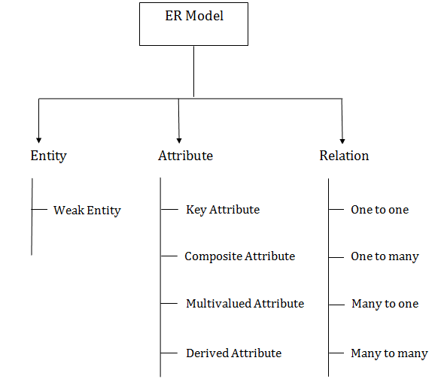
Component of ER Diagram

Slide 4


Entity - An entity may be any object, class, person or place. In the ER diagram, an entity can be represented as rectangles. Consider an organization as an example- manager, product, employee, department etc. can be taken as an entity.
Weak Entity - An entity that depends on another entity called a weak entity. The weak entity doesn't contain any key attribute of its own. The weak entity is represented by a double rectangle.

Slide 5
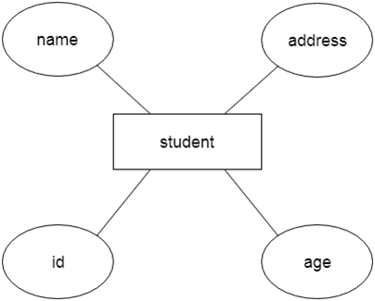
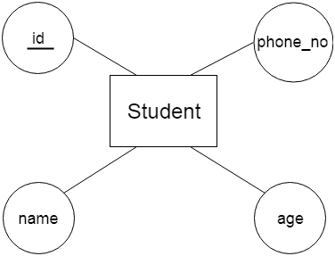
Attribute - The attribute is used to describe the property of an entity. Eclipse is used to represent an attribute. For example, id, age, contact number, name, etc. can be attributes of a student.
Key Attribute - The key attribute is used to represent the main characteristics of an entity. It represents a primary key. The key attribute is represented by an ellipse with the text underlined.

Slide 6
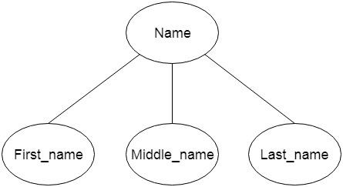
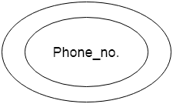
Composite Attribute - An attribute that composed of many other attributes is known as a composite attribute. The composite attribute is represented by an ellipse, and those ellipses are connected with an ellipse.
Multi-valued Attribute - An attribute can have more than one value. These attributes are known as a multi-valued attribute. The double oval is used to represent multi-valued attribute.
For example, a student can have more than one phone number.

Slide 7
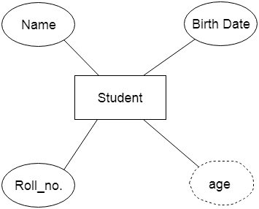
Derived Attribute - An attribute that can be derived from other attribute is known as a derived attribute. It can be represented by a dashed ellipse.
For example, A person's age changes over time and can be derived from another attribute like Date of birth.

Slide 8


Relationship - A relationship is used to describe the relation between entities. Diamond or rhombus is used to represent the relationship.
Types of relationship are as follows –
One-to-One Relationship - When only one instance of an entity is associated with the relationship, then it is known as one to one relationship. For example, A female can marry to one male, and a male can marry to one female.

Slide 9


One-to-many Relationship - When only one instance of the entity on the left, and more than one instance of an entity on the right associates with the relationship then this is known as a one-to-many relationship.
For example, Scientist can invent many inventions, but the invention is done by the only specific scientist.
Many-to-one relationship - When more than one instance of the entity on the left, and only one instance of an entity on the right associates with the relationship then it is known as a many-to-one relationship.
For example, Student enrolls for only one course, but a course can have many students.

Slide 10

Many-to-many relationship - When more than one instance of the entity on the left, and more than one instance of an entity on the right associates with the relationship then it is known as a many-to-many relationship.
For example, Employee can assign by many projects and project can have many employees.

Slide 11
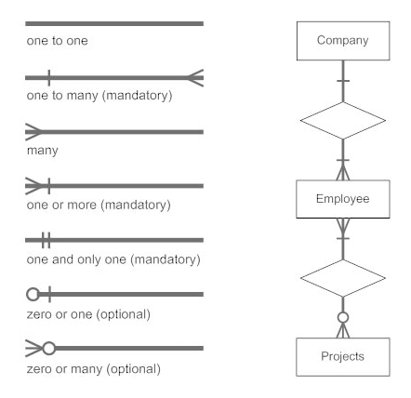
Notation of ER diagram
Database can be represented using the notations. In ER diagram, many notations are used to express the cardinality.
These notations are as follows -

Slide 12
Mapping Constraints
A mapping constraint is a data constraint that expresses the number of entities to which another entity can be related via a relationship set.
It is most useful in describing the relationship sets that involve more than two entity sets.
For binary relationship set R on an entity set A and B, there are four possible mapping cardinalities.
These are as follows:
One to one (1:1)
One to many (1:M)
Many to one (M:1)
Many to many (M:M)

Slide 13
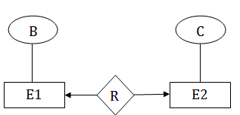
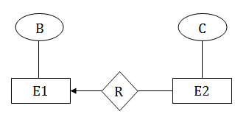
One-to-One - In one-to-one mapping, an entity in E1 is associated with at most one entity in E2, and an entity in E2 is associated with at most one entity in E1.
One-to-Many - In one-to-many mapping, an entity in E1 is associated with any number of entities in E2, and an entity in E2 is associated with at most one entity in E1.

Slide 14
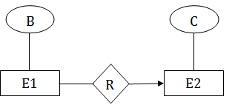
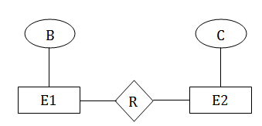
Many-to-One - In one-to-many mapping, an entity in E1 is associated with at most one entity in E2, and an entity in E2 is associated with any number of entities in E1.
Many-to-Many - In many-to-many mapping, an entity in E1 is associated with any number of entities in E2, and an entity in E2 is associated with any number of entities in E1.

Slide 15
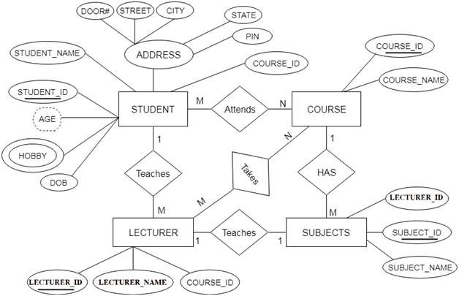
Sample Example of ER Diagram

Slide 16
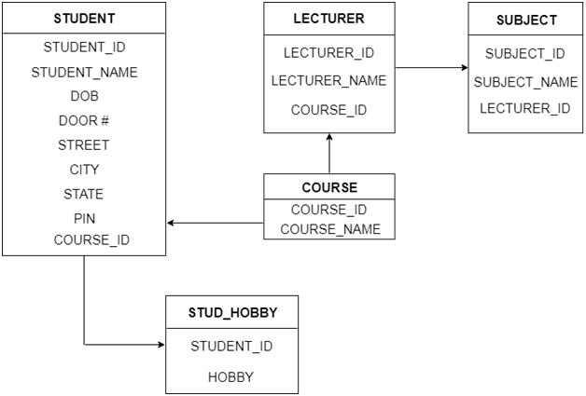
Database Table Structure

Slide 17
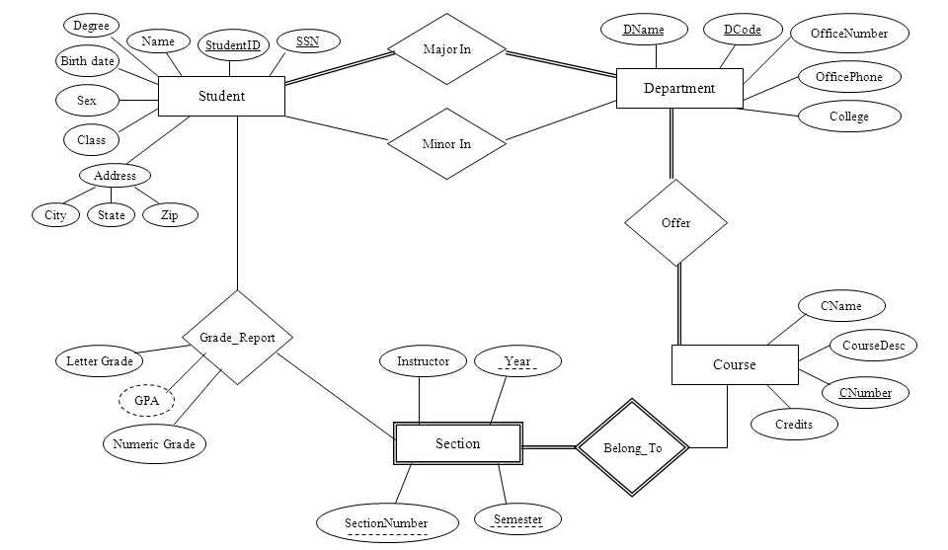
Sample Example of University ER Diagram

Slide 18
Database Keys
Keys play an important role in the relational database.
It is used to uniquely identify any record or row of data from the table. It is also used to establish and identify relationships between tables.
For example: In Student table, ID is used as a key because it is unique for each student. In PERSON table, passport_number, license_number, SSN are keys since they are unique for each person.
Types of Different Keys:
Super Key | Candidate Key | Primary Key | Secondary key | Foreign Key
Unique Key | Composite Key | Surrogate Key | Partial Key | Alternate Key

Slide 19
Super Key: | An attribute (or combination of attributes) that uniquely identifies each record separately.
Candidate Key: | A mechanical super key i.e., a super key that does not contain, a subset of attributes that is itself a super key.
Primary Key: | A candidate key, selected to uniquely identify all other attributes values in any given row & it can not contain any null values.
Secondary Key: | An attribute (or combination of attributes) used strictly for data retrieval purpose.
Foreign Key: | An attribute (or combination of attributes) with in one table with values must either match the primary key of the another table or null.
Unique Key: | A unique key is a set of one or more than one fields/columns of a table that uniquely identify a record in a database table. We can say that it is little like primary key but it can accept only one null value and it cannot have duplicate values.
Composite Key: | A composite key is a candidate key that consists of two or more attributes (table columns) that together uniquely identify an entity occurrence (table row).

Slide 20
Surrogate Key: | A Surrogate key is a key with virtual or no actual reason, and it is used for representing the existence for data analysis. Thus, a surrogate key is used for representing existence for data analysis. It is the unique identifier in a database.
Partial Key: | Partial key is a key using which all the records of the table can not be identified uniquely. However, a bunch of related tuples can be selected from the table using the partial key.
Alternate Key: | A candidate key which is not a primary key, is known as an alternate key.

Slide 21
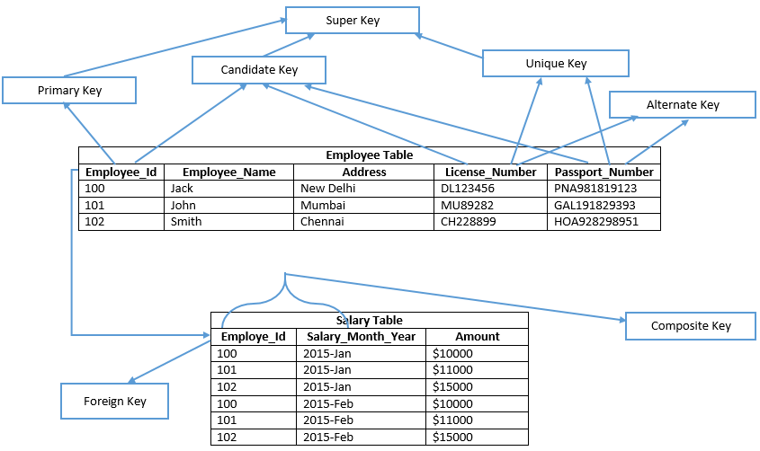

Slide 22
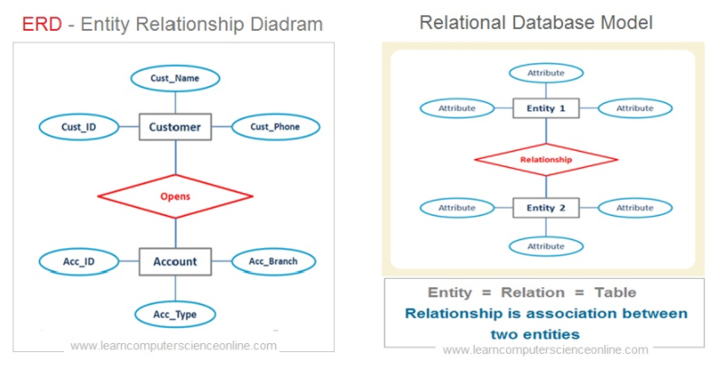

Slide 23
